Slide 1
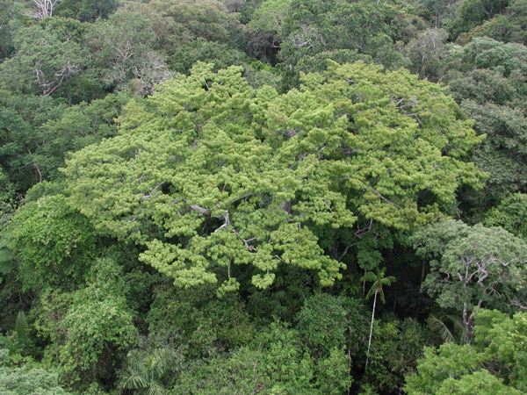

e-Sensing: Big Earth observation data analytics for land use and land cover change information

Slide 2
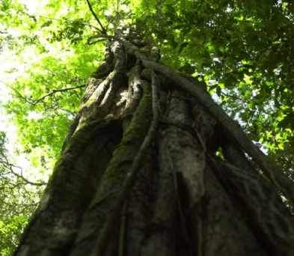
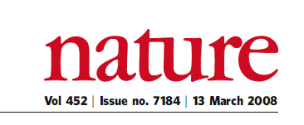
“A few satellites can cover the entire globe, but there needs to be a system in place to ensure their images are readily available to everyone who needs them. Brazil has set an important precedent by making its Earth-observation data available, and the rest of the world should follow suit.”

Slide 3
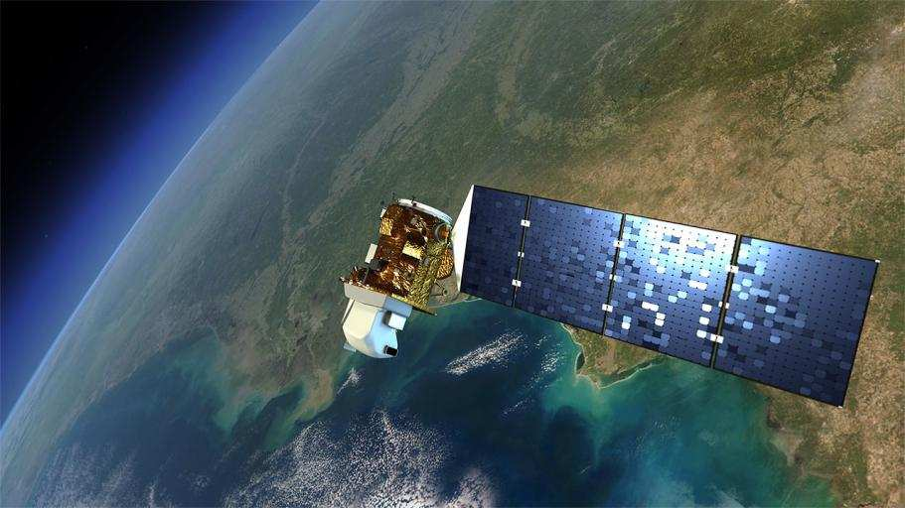
Earth Observation data is now free…and big
graphics: NASA
Sentinels + CBERS + LANDSAT + …: > 10Tb/day

Slide 4
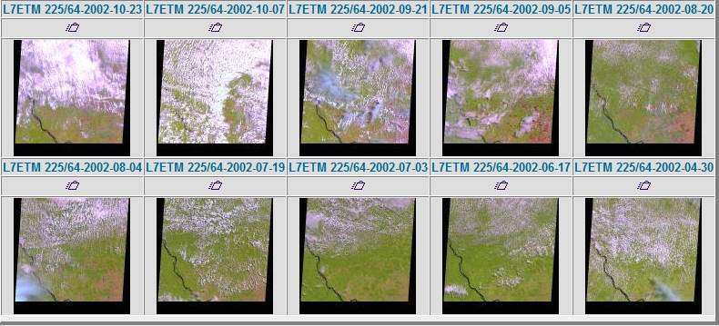
Is free data download our answer?
Currently, users download one snapshot at a time
Notes:
Este slide mostra o impacto da cobertura de nuvens sobre a analise de imagens. Esta é uma região do Pará, onde todas as imagens durante o ano de 2002 tem cobertura de nuvens. Para reduzir este impacto, o INPE analisa varias imagens para uma mesma regiao.

Slide 5
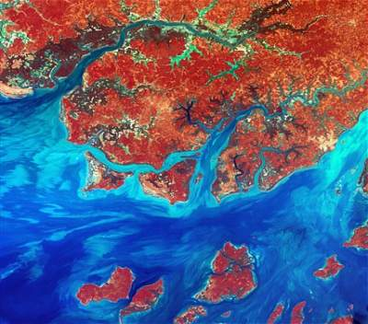
Data Access Hitting a Wall
How do you download a petabyte?
You don’t! Move the software to the archive

Slide 6


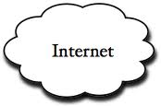
Where we want to get to
Remote visualization and
method development
Big data EO management and analysis
40 years of Earth Observation data of land change accessible for analysis and modelling.

Slide 7
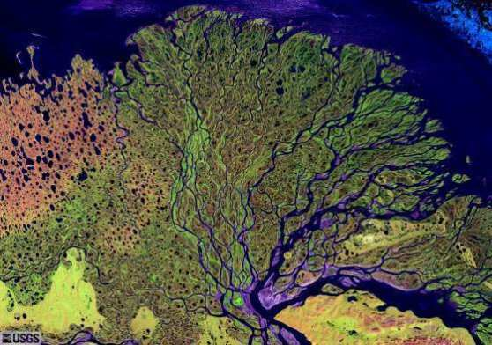
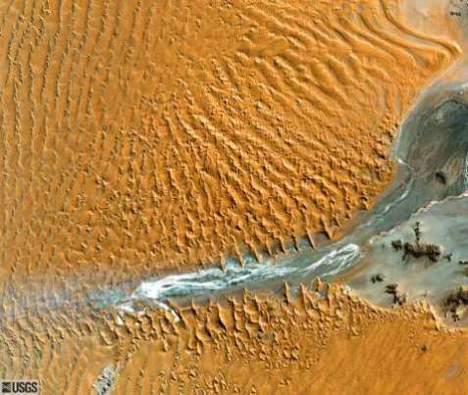
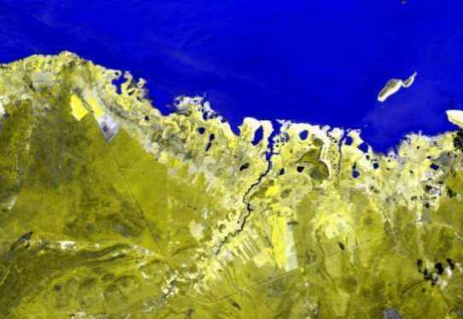
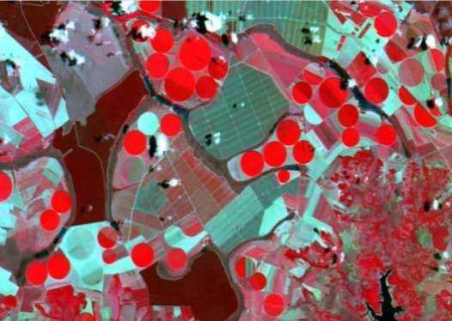
What are we looking for in big EO data?

Slide 8
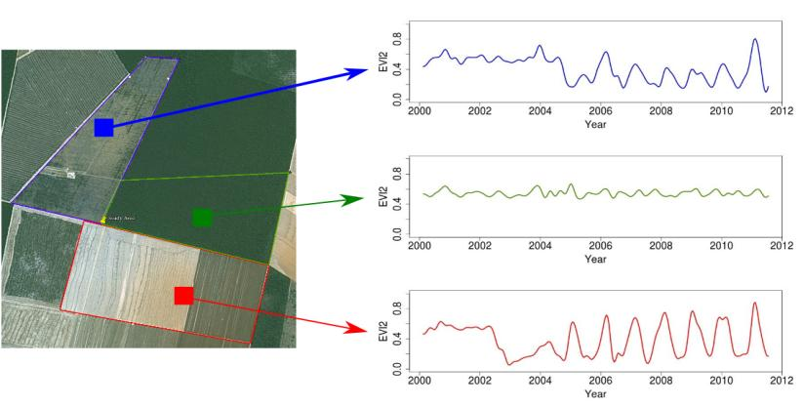
Land trajectories
Forest
Pasture
Agric
Área 1
Forest
Área 2
Forest
Agriculture
Área 3
“The transformations of land cover due to actions of land use”
graphics: Victor Maus (INPE, IFGI)

Slide 9
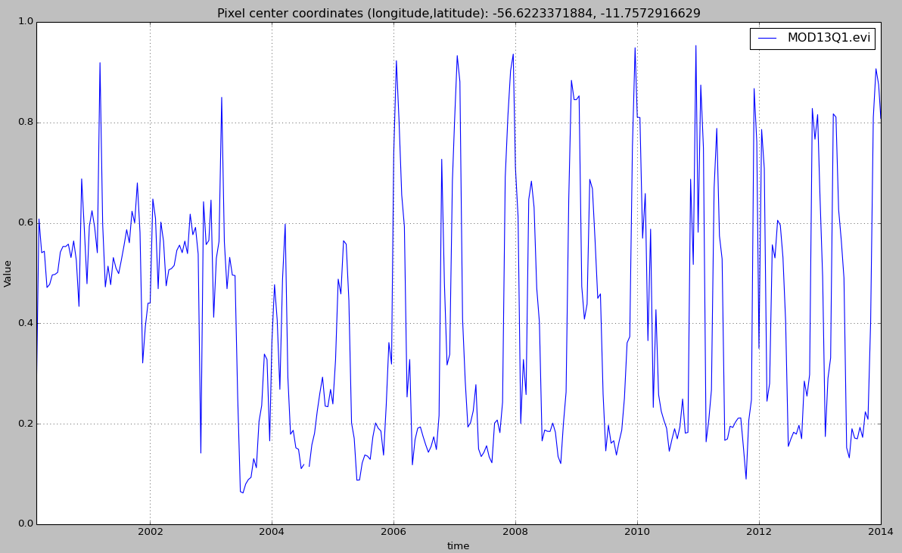

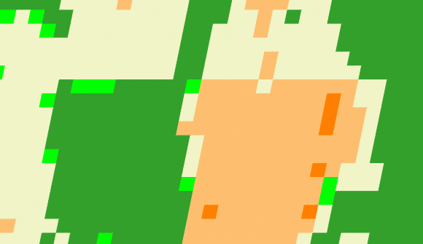
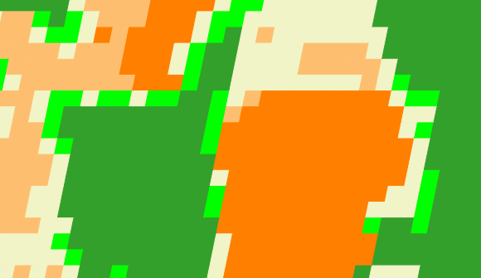
Land trajectories
Forest
Single cropping
Double cropping
2001
2006
2013

Slide 10
How do we find what we want in big EO data?

Slide 11
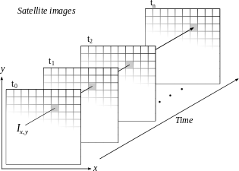
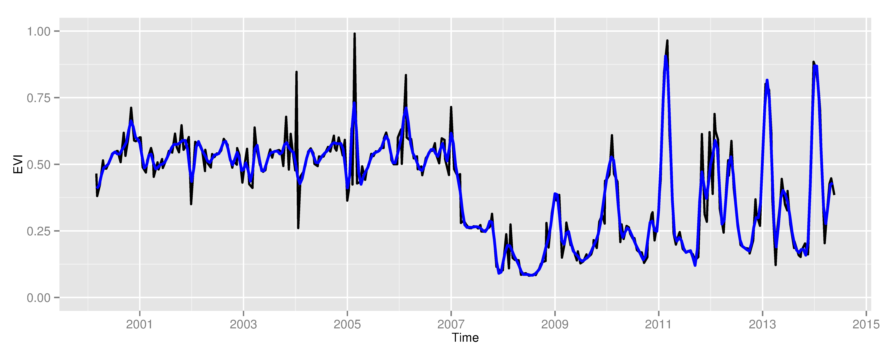
Space first, time later or time first, space later?
Space first: classify
images separately
Compare results in time
Time first: classify
time series separately
Join results to get maps

Slide 12
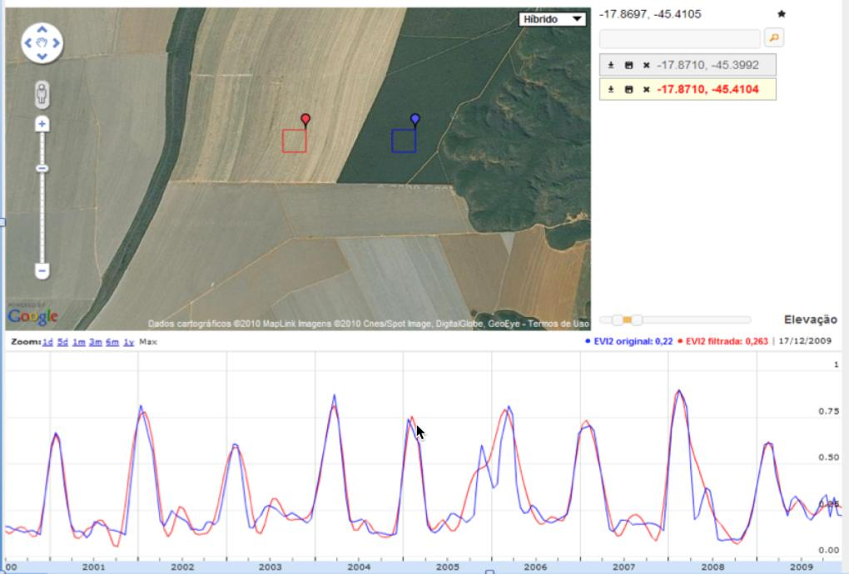
Land trajectories in agriculture
graphics: LAF/INPE
source: INPE

Slide 13
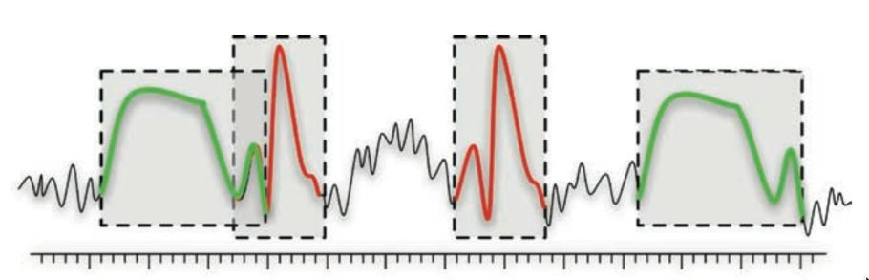
Time series mining: pattern matching
Finding subsequences in a time series
High computational complexity
Patterns are idealized, data is noisy
Esling & Agon (2012)

Slide 14
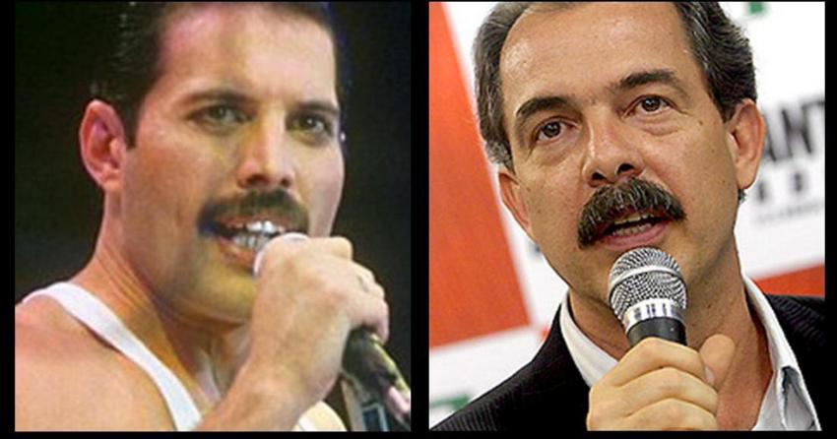
What is similarity?
resemblance, likeness, sameness, comparability, correspondence, analogy, parallel, equivalence;
adapted from Keogh (2006)

Slide 15
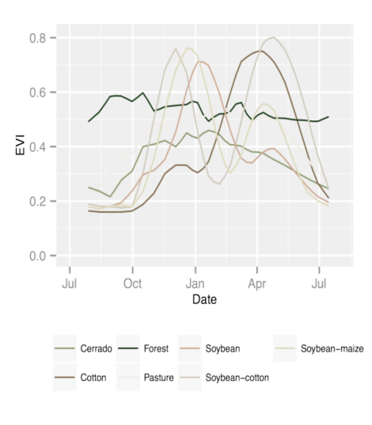
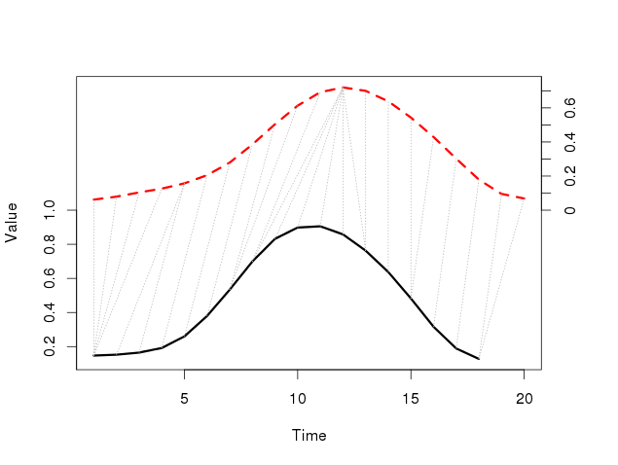
Dynamic Time Warping: pattern matching
Arvor et al (2012), Eamon Keogh
DTW “warps” the time axis: nonlinear matching

Slide 16
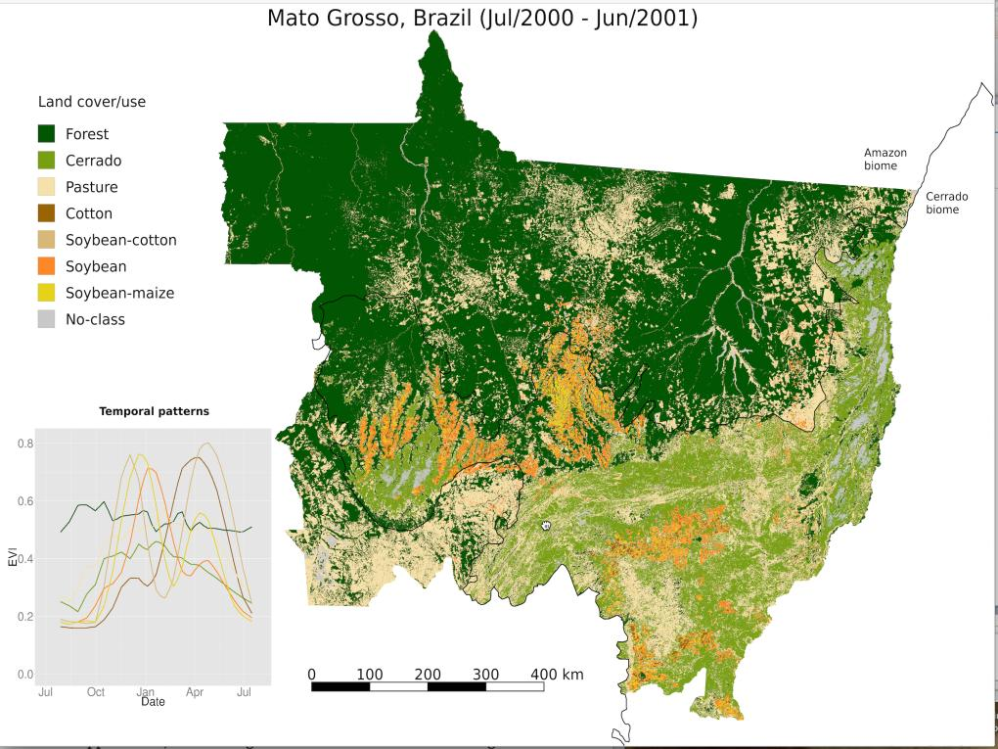
Victor Maus

Slide 17
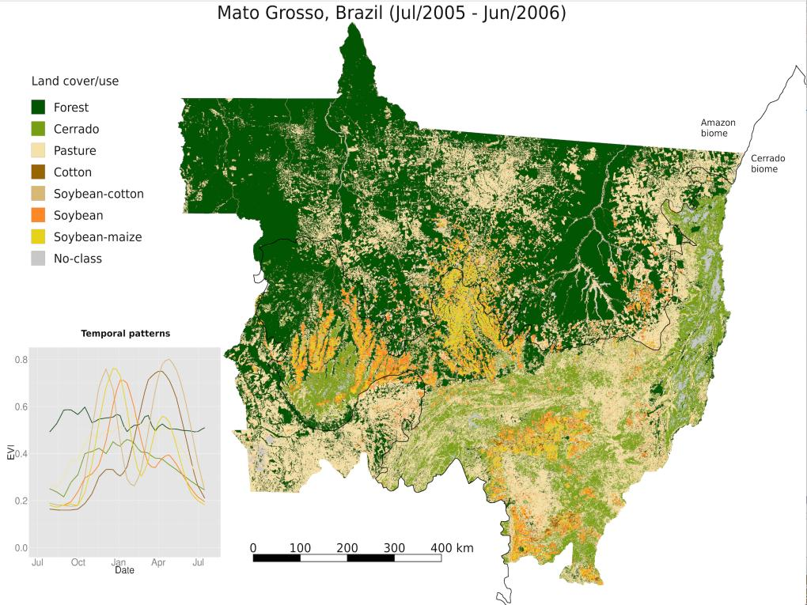
Victor Maus

Slide 18
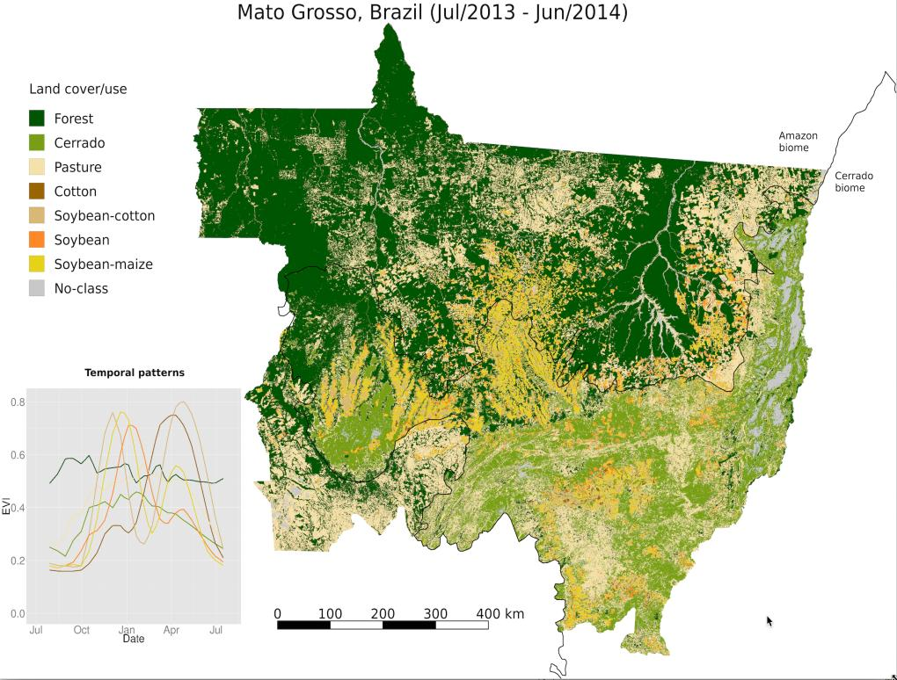
Victor Maus

Slide 19
How do we handle big EO data?

Slide 20
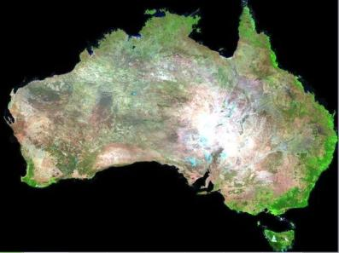


Big data requires new conceptual views
How can we best use the information provided by big data sources?
Image source: Geoscience Australia

Slide 21
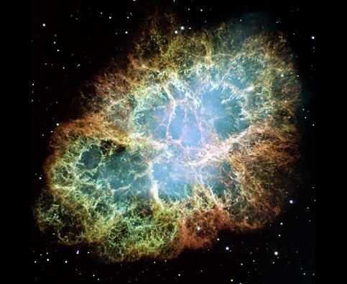
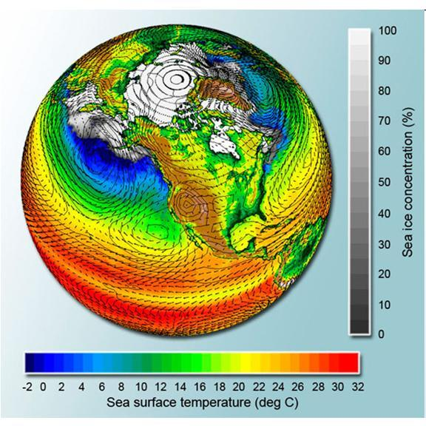
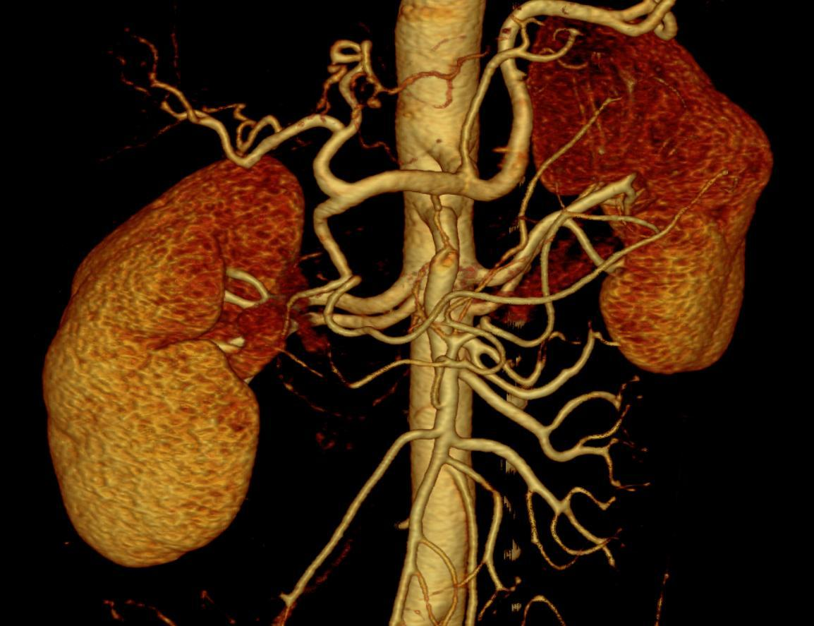
What do these data have in common?

Slide 22
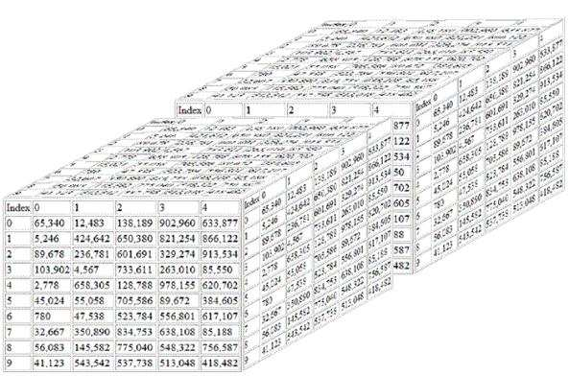
Scientific data: multidimensional arrays
y
t
X
g = f (<x,y,z> [a₁, ….a_{n}])

Slide 23
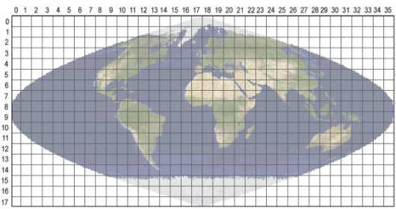
Array databases: all data from a sensor put together in a single array
t
y
y
X
result = analysis_function (points in space-time )

Slide 24
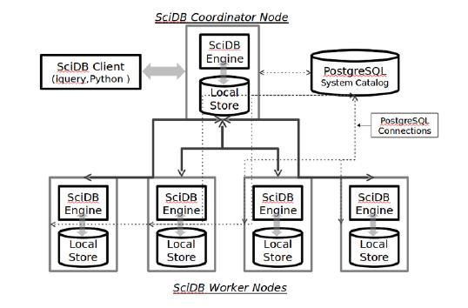
SciDB Architecture: “shared nothing”
image: Paul Brown (Paradigm 4)
Large data is broken into chunks
Distributed server process data in paralel

Slide 25
http://www.dpi.inpe.br/wtss/time_series?
coverage=MOD09Q1,attributes=red,nir&
longitude=-54,latitude=-12&start=2000-02-18&end=2000-03-05
WTSS
(TerraLib + SciDB C++ API)
WTSS Client
JSON Document
SciDB
(Arrays)
PostgreSQL
(Metadados)
{"result": {
"attributes":[ { "name": "red",
"values": [ 1004, 1160, 241 ]
},
{ "name": "quality",
"values": [ 4842, 3102, 2116 ]
}
],
"timeline": [ "2000-02-18", "2000-02-26", "2000-03-05" ],
"center_coordinates": { "latitude": -11.99, "longitude": -53.99
}
},
"query": {
"coverage": "MOD09Q1",
"attributes":[ "red", "quality" ],
"latitude": -12,
"longitude": -54,
"start": "2000-02-18",
"end": "2000-03-05"
}
}
WTSS – Web Time Series Service: a lightweight service for serving remote sensing imagery as time series
Queiroz et al., 2015

Slide 26
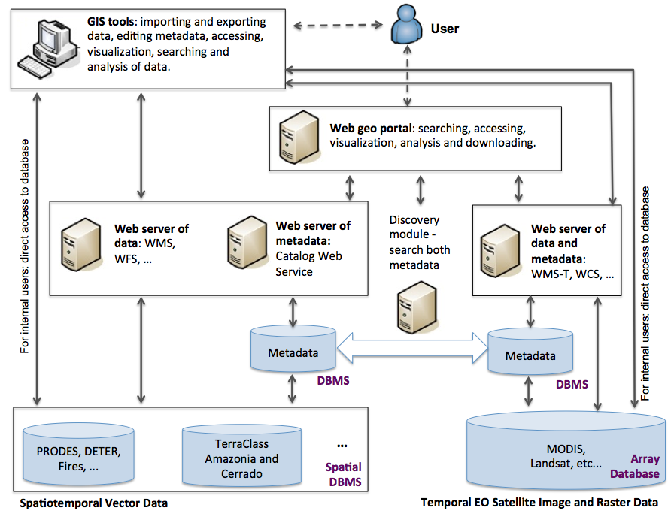
SDI for big Earth Observation data
Ferreira et al., 2015

Slide 27


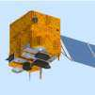

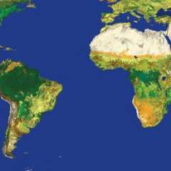

Open source and open data = knowledge sharing
R: Powerful data analysis methods
SciDB: array database for big scientific data
Free satellite
images

Slide 28
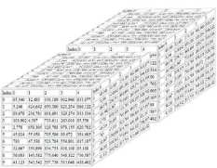
Global Land Observatory: describing change in a connected world
Methods for land change for forestry and agriculture uses
40 years of LANDSAT + 12 years of MODIS + SENTINELs + CBERS
Unique repository of knowledge and data about global land change

