Slide 1
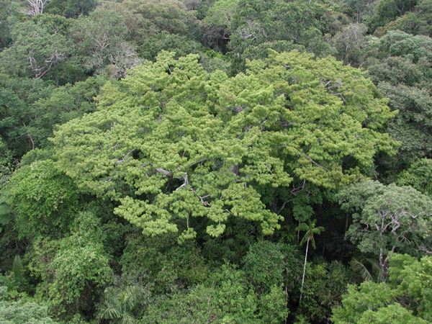
Satellite image time series analysis using time-weigthed dynamic time warping

Slide 2
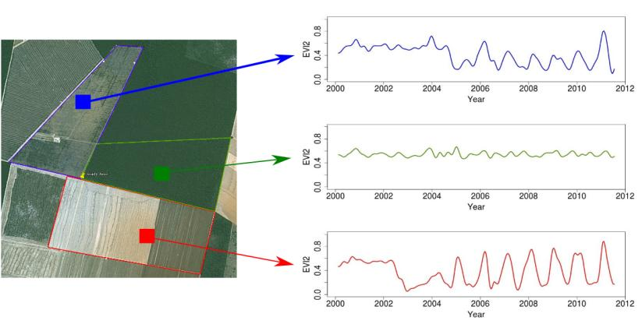
Land trajectories
Forest
Pasture
Agric
Área 1
Forest
Área 2
Forest
Agriculture
Área 3
“The transformations of land cover due to actions of land use”
graphics: Victor Maus (INPE, IFGI)

Slide 3
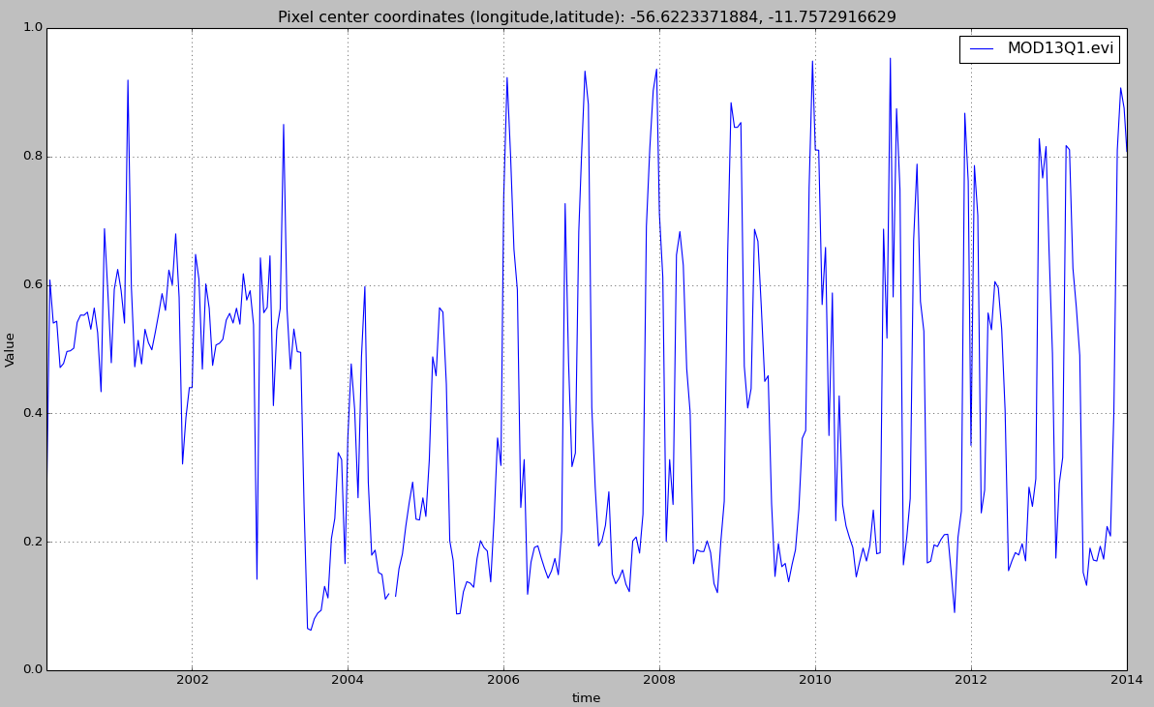

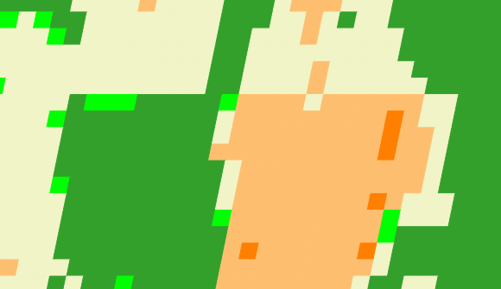
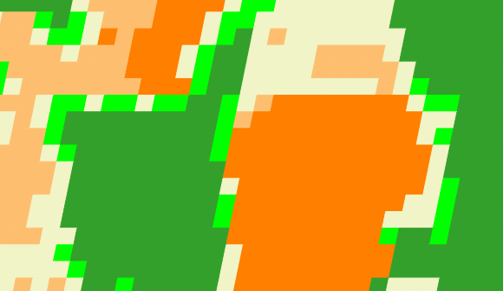
Land trajectories
Forest
Single cropping
Double cropping
2001
2006
2013

Slide 4
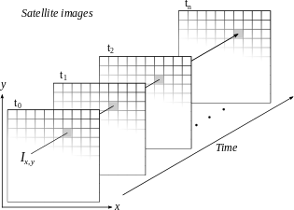
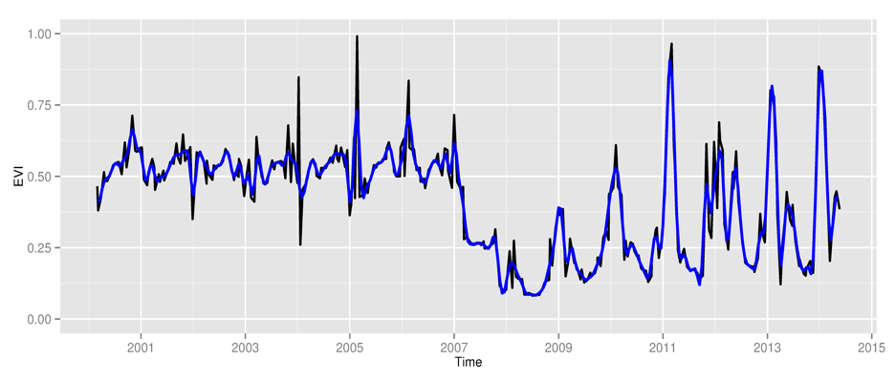
Space first, time later or time first, space later?
Space first: classify
images separately
Compare results in time
Time first: classify
time series separately
Join results to get maps

Slide 5
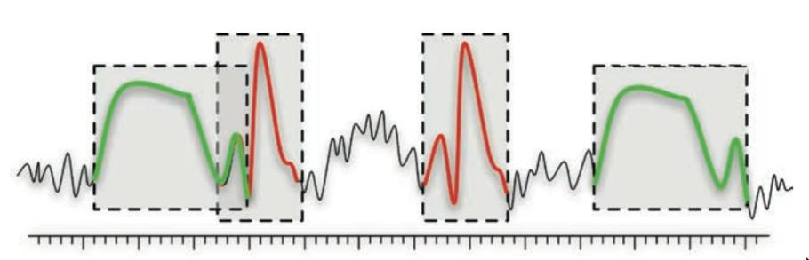
Time series mining: pattern matching
Finding subsequences in a time series
High computational complexity
Patterns are idealized, data is noisy
Esling & Agon (2012)

Slide 6
Dynamic time warping: pattern matching
DTW finds alignments of short templates in a long time series

Slide 7
Patterns derive from phenological cycles
Temporal patterns of EVI modis 16 days

Slide 8
Patterns should match agricultural calendar
Balance between shape matching and temporal alignment
(matches distant in time are penalised)

Slide 9
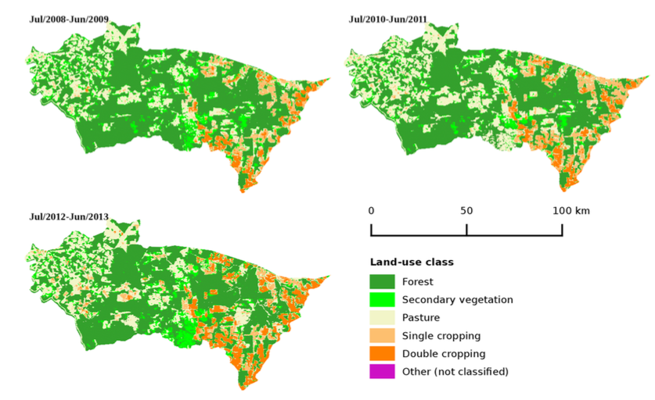
Porto dos Gaúchos, MT
Maus et al. (2015)

Slide 10
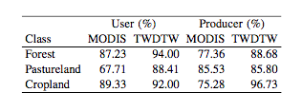
MODIS Land Cover x Time-weighted DTW
Producer's accuracy: fraction of correctly classified pixels compared to all pixels of that ground truth class
User's accuracy (reliability): fraction of correctly classified pixels of a class compared to all pixels classified as being that class

Slide 11

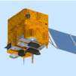


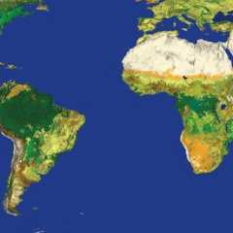
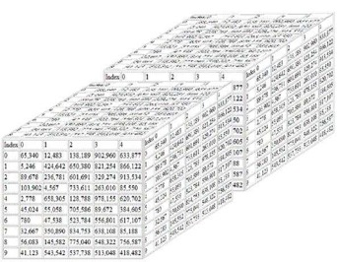

R package dtwSat
dtwSat package
SciDB array database
or
Geotiff files

Slide 12
dtwSat: templates based on ground truth
Input: set of space-time locations (x, y, t_{start}, t_{end}, class)
Output: templates for each class (fitted statistical model)

Slide 13
dtwSat: classifying image time series

Slide 14
dtwSat: classifying spacetime images

Slide 15
dtwSat: classifying spacetime images
Percentage of land cover class from 2008 to 2013

Slide 16
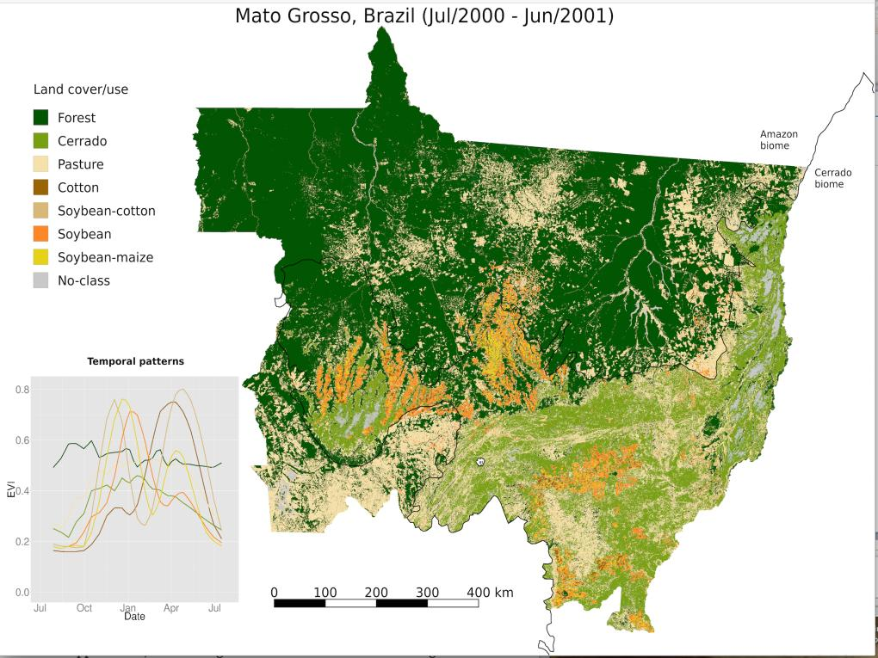
Victor Maus

Slide 17
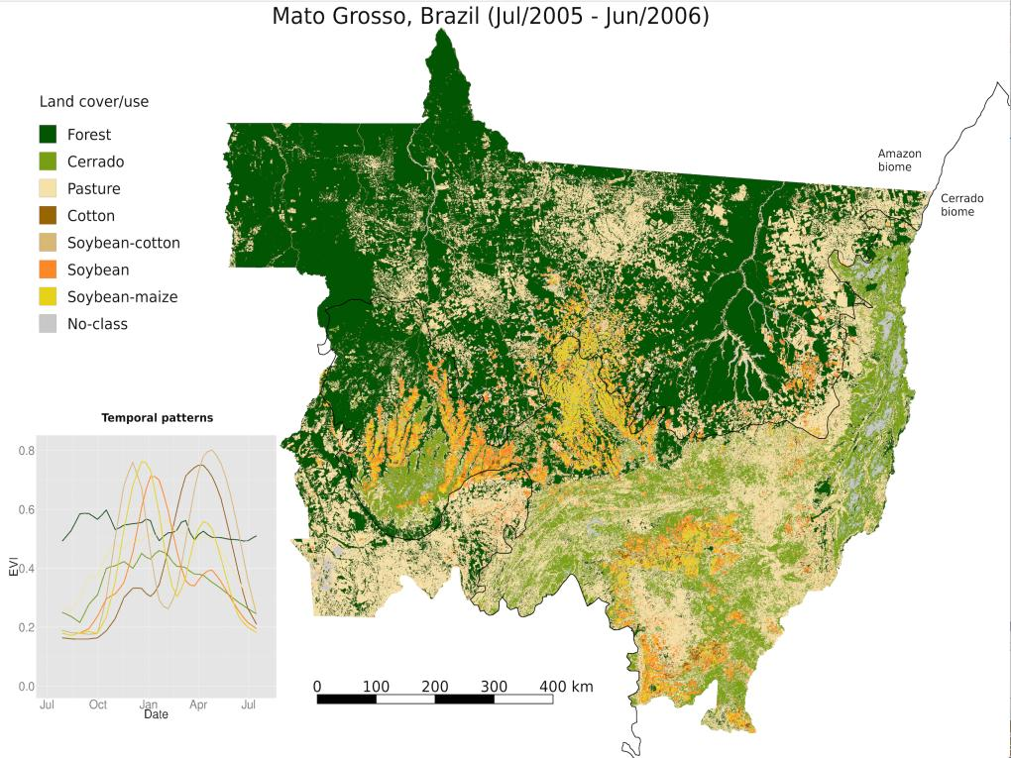
Victor Maus

Slide 18
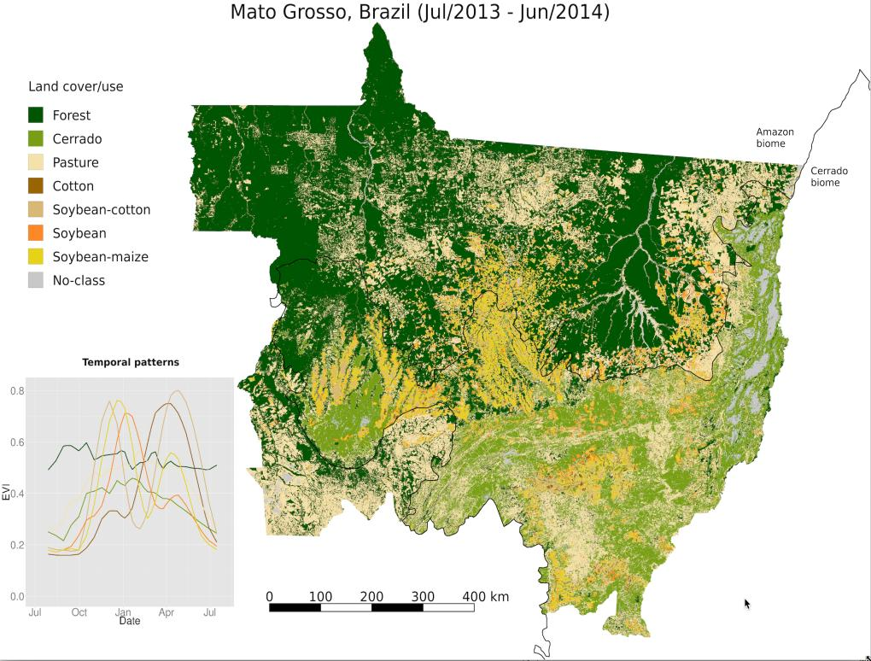
Victor Maus

